Slide 1
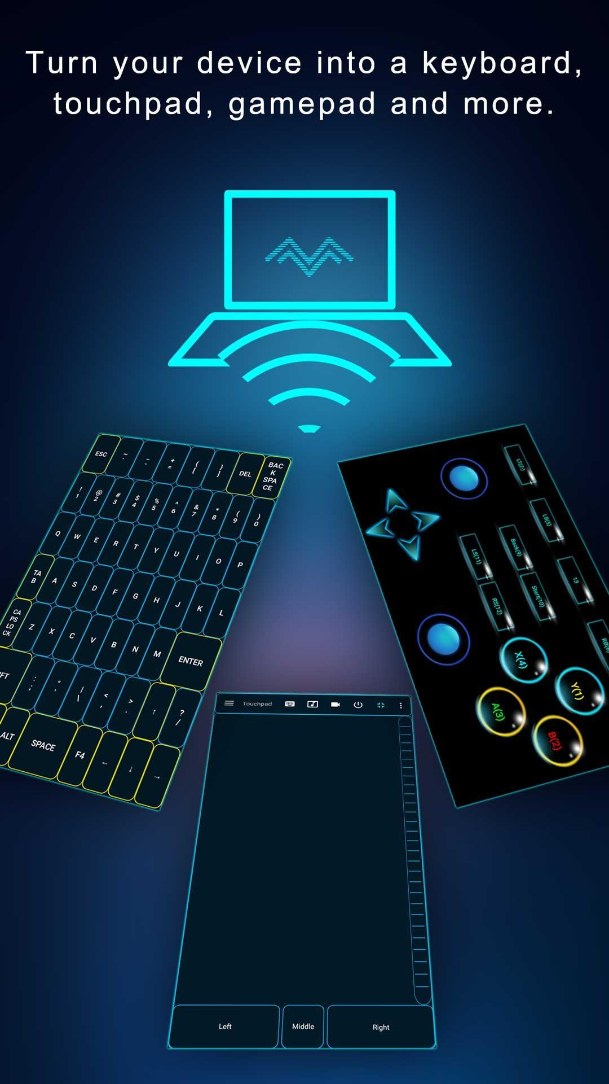
Screen Honcho

Slide 2
TEAM MEMBERS
Ayush Singh Chauhan (181500180)
Kshitij Gupta (181500336)
Rachit Rai (181500524)
Rohit Gupta (181500590)
Ayush Gupta (181500173)
GitHub: https://github.com/cybertronayush/Screen-Honcho

Slide 3

PROBLEM STATEMENT
This project is aimed at developing an app to use your Android phone to control your Laptop.
This application will be very initiative and would have features like Control Left Click, Right Click, Mouse Scroll, Type text Transfer files from phone to laptop, all the basic media and computer control.
For this project we’ll need Android Studio for our app implementation, Kotlin Language for backend, XML also used MVVM for application frontend and architectural layout.

Slide 4

ISSUES AND CHALLENGES
Wireless keyboard has limited flexibility and is not convenient for a presenter to carry it around in the room during the presentation.
Wireless presentation controller does have good mobility. However, most of such devices do not allow user to have full operation on the computer, such as running a program, moving or closing an application window, etc.
Even it has a small touchpad for moving mouse cursor, however it is very difficult for the presenter to use it

Slide 5
REQUIREMENTS FOR MAKING PROJECT
Android Studio (for building the app)
Application Program Interface (for real-time data)
Kotlin as a programming language for backend
HTML(Hyper Text Markup Language)
XML for layout designing
JAVA FX
Emulator or an android device to test the app
Git and Github for version control

Slide 6

ADVANTAGES OF KOTLIN OVER JAVA
It leverages precisely the language design expertise built up over these last 20 years since Java's been around.
It's been packed with all the much-needed modern features that Java mobile developers have been longing for: programming language features that have already proven their efficiency with large-scale projects.
It's Completely Interoperable with Java
Better Support for Functional Programming It's Easier to Maintain

Slide 7
JAVA FX
JavaFX is an open source Java-based framework for developing rich client applications..
JavaFX is a software platform for creating and delivering desktop applications, as well as rich internet applications (RIAs) that can run across a wide variety of devices.
JavaFX is intended to replace Swing as the standard GUI library for Java SE, but both will be included for the foreseeable future. JavaFX has support for desktop computers and web browsers on Microsoft Windows, Linux, and Mac OS X.

Slide 8

KOTLIN
KOTLIN is a cross-platform, statically typed, general-purpose programming language with type inference.
Kotlin is designed to interoperate fully with Java, and the JVM version of Katlin’s standard library depends on the Java Class Library.
Although, you can use both Kotlin and Java to develop native android apps, Google announced in 2019 to make Kotlin the preferred way of developing android applications. If you were to start learning android development today, Kotlin is our language of choice.

Slide 9
PREPARING PROJECT DETAILS
Feasibility Report: As every project created first time needs to go through the feasibility check to ensure whether or not it can be build.
Architectural Decision Record: The next step is to make it clear what we trying to build. For that, ADR is a good way to understand the project with different perspective by creating different diagrams.
Wireframes: The third step is to make a raw structure of the project. Here we have build different screens of the project app.
Note: All the above mentioned details of the project are uploaded on github.

Slide 10
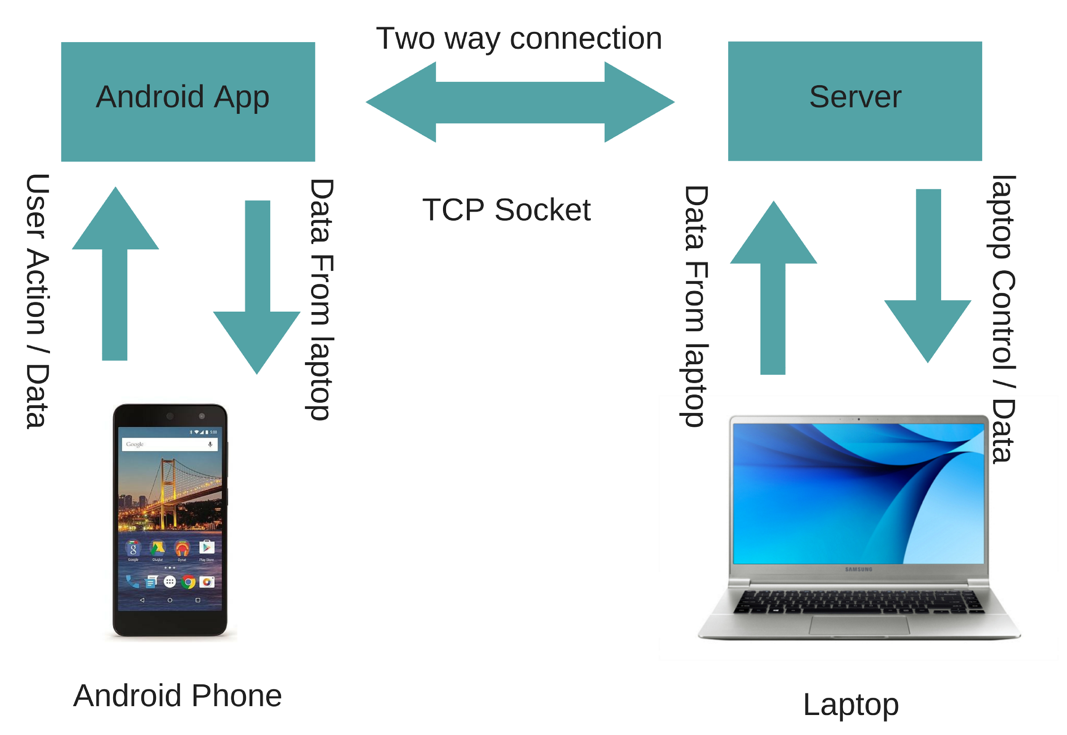
WORKING MODEL

Slide 11
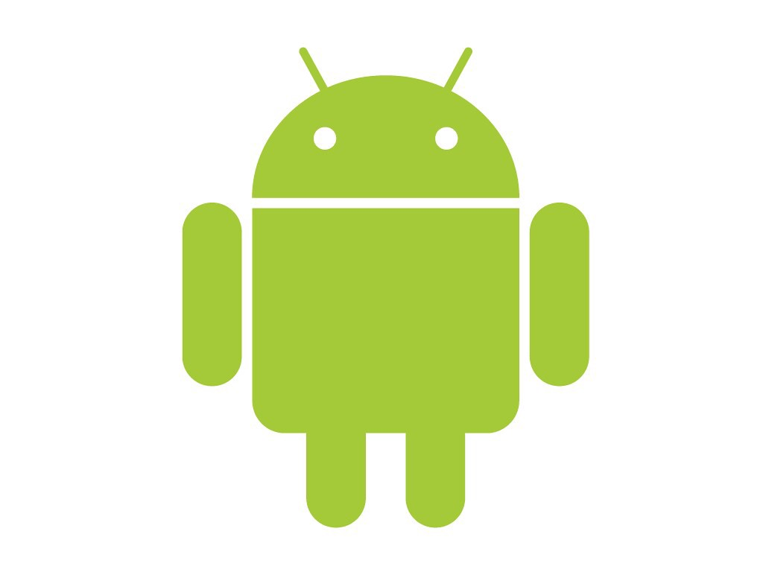
SCREENS IN THE APP
Live Screen
Touchpad
Keyboard
File Transfer
File Download
Image Viewer
Media Player
Presentation
Power Off

Slide 12
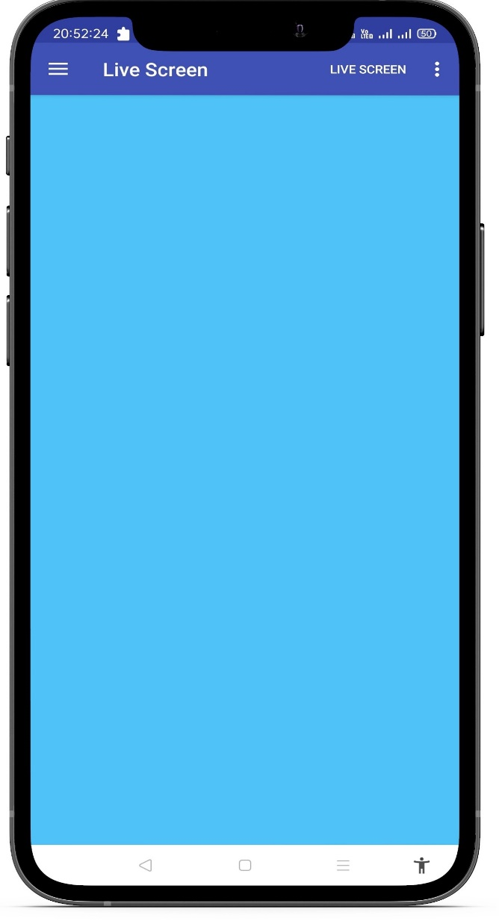
LIVE SCREEN
This Activity will let you interact with Live Laptop screen and from here user can And from here you can navigate and perform mouse like Operation from this Android Application. Offers interactive multi-touch and gesture options for easy control.

Slide 13
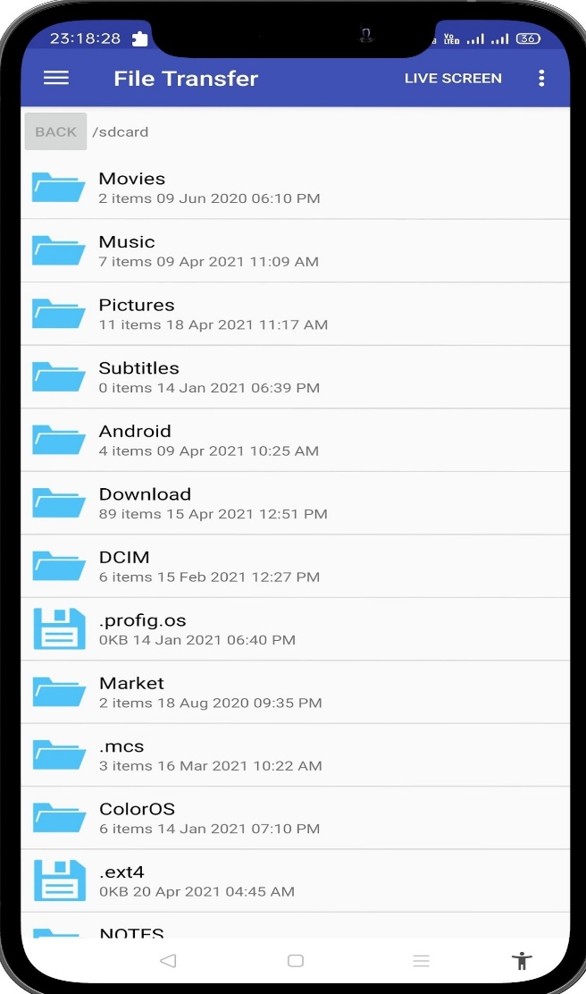
TOUCHPAD
As the name suggest Touchpad this activity has functionality exactly like laptop trackpad.From this activity you can perform functionalities that trackpad can perform.

Slide 14
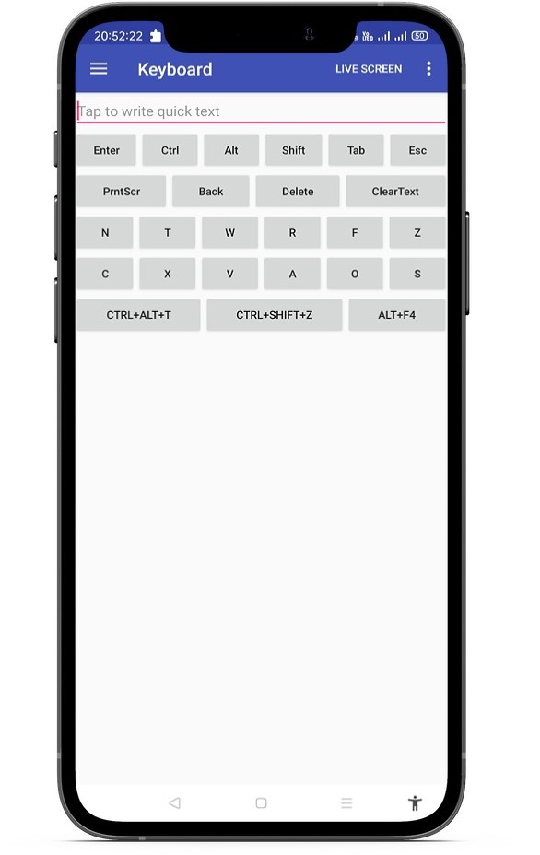
KEYBOARD
Wireless keyboard, uses either Bluetooth or wireless USB mini-receiver plugged into the USB port of computer for the communication between the keyboard and the computer..

Slide 15
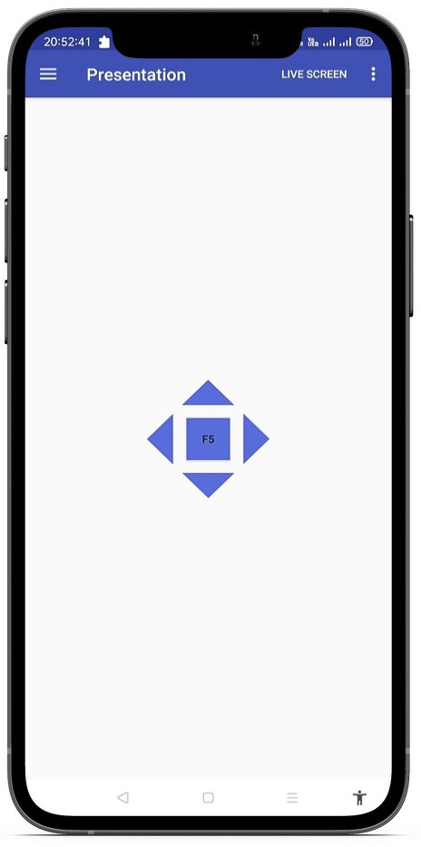
PRESENTATION
Wireless presentation controller, allows user to operate his/her computer remotely for PowerPoint presentation through Bluetooth connection.

Slide 16
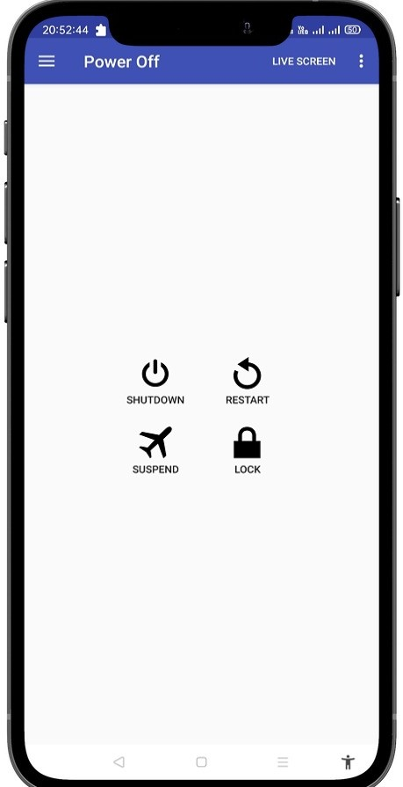
POWER CONTROLS
This is the power Control function.Here user can Restart the App,ShutDown the App and Also can Suspend it.

Slide 17
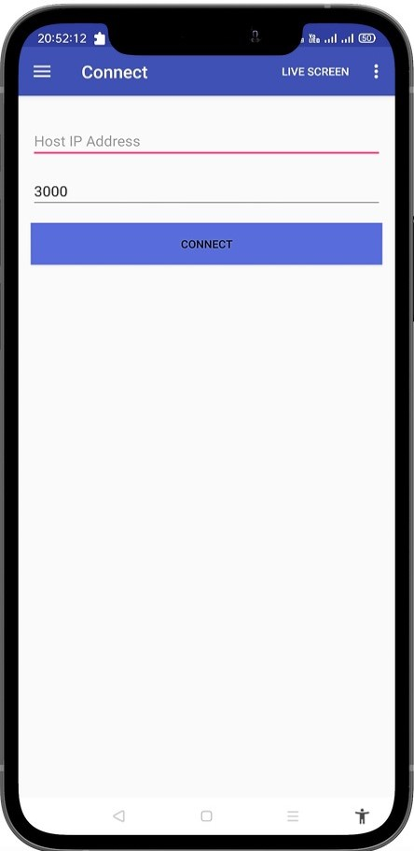
CONNECTION
This Screen will let you enter IP address of your desktop,So that you can connect your Android Device with your Desktop.

Slide 18
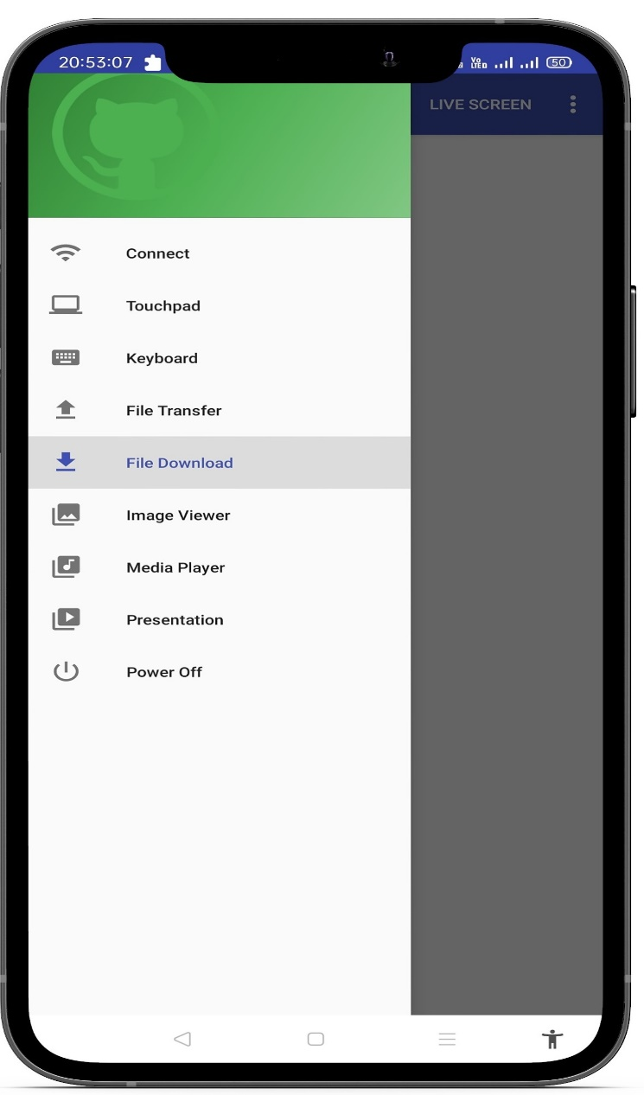
HAMBURGER MENU

Slide 19


